Slide 1
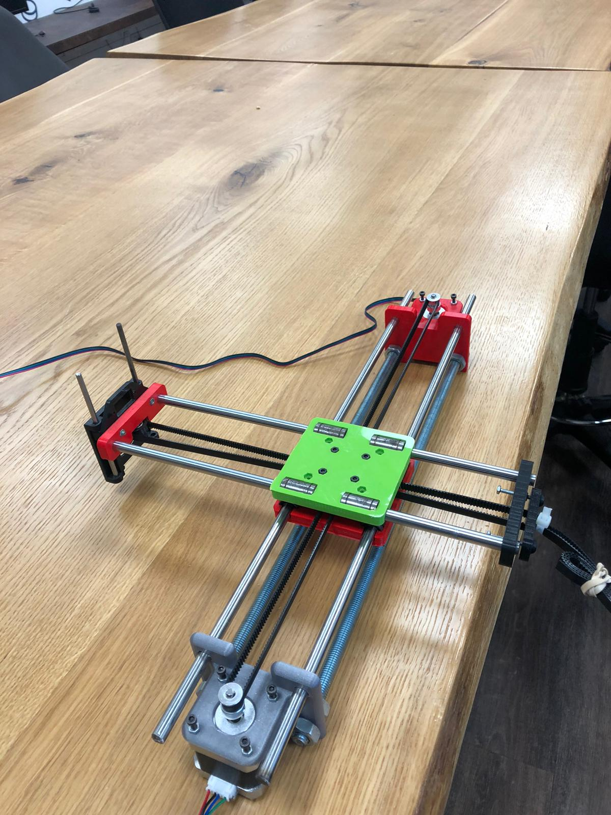
PaintBot

Slide 2
Overview
Our project is a robot that paints in watercolors a draw from an app.
We are using an ESP32 to control two stepper motors. The motors move a robotic arm with a brush attached to it.
The user draws on our app and upload the draw to Firebase. The ESP downloads the data from firebase (Wi-Fi) and moves the motors accordingly.

Slide 3
System Diagram
Firebase
Stepper 1
Wi-Fi
ESP32
Servo
Flutter app
User input
Stepper 2

Slide 4
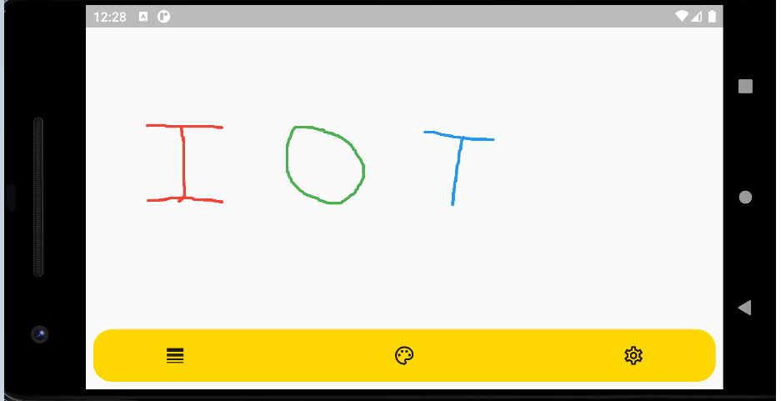
Flutter app

Slide 5
Achievements
We finished the drawing app.
We finished the main framework of the robot.
The Flutter-FireBase-ESP-Robot chain is complete.

Slide 6
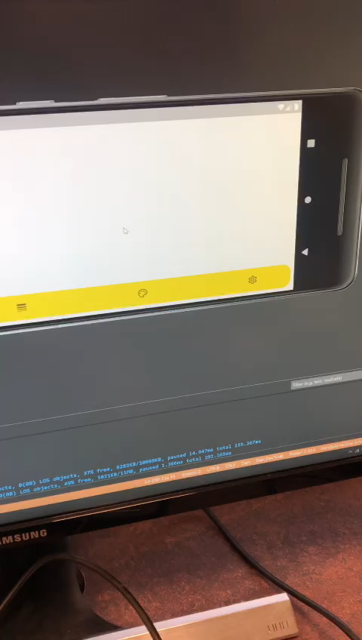
Demo

Slide 7
Challenges
Add lift up-down feature for the brush (servo motor).
Fine tune robot moves to create a more accurate draw.
Add stop switches to allow “back home” feature.

Slide 8
Destination list
Hardware (Robot) | Hardware (ESP) | Application | Week
Add brush | Fine tune robot moves | Add up-down movement. Improve Bresenham algorithm. | 7
Add different paints and cleaning gear. | Add “back-home” feature and up-down movements (servo motor). | Add colors + cleaning movements algorithm. | 9
Move to welded and steady station. |  | More feedback from robot to user (possible further features). | 11
Encapsulate robot in a final box | Final testing | Final testing | 13

